Slide 1
DSC 530 Final Project
Ashley Deibler

Slide 2
Statistical Question:
Is square footage the largest influencer in determining listing price for real estate?

Slide 3
Variables
Variable
Meaning of Variable
List Price
Square Feet
Number of Bedrooms
Year Built
Number of Bathrooms
Price in USD of homes listed for sale.
Number of square feet the property consists of
Number of bedrooms within the home
The year the home was built
Number of bathrooms in the home (half and full).

Slide 4
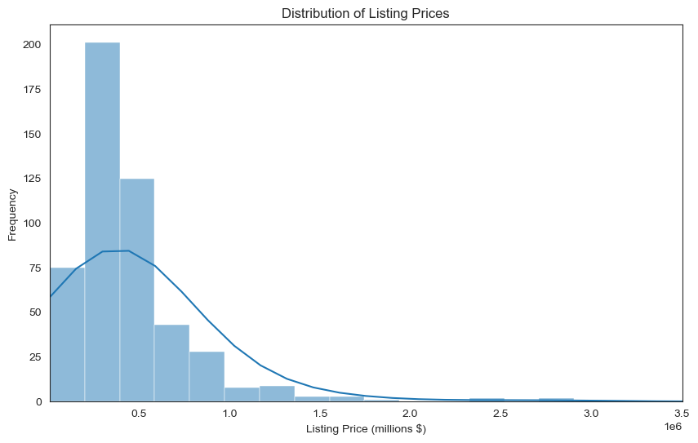
Histogram for Listing Prices

Slide 5
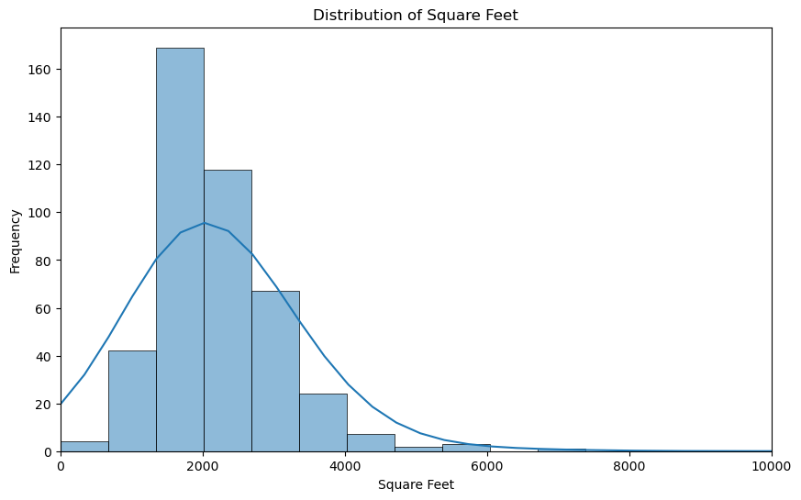
Histogram for Square Feet

Slide 6
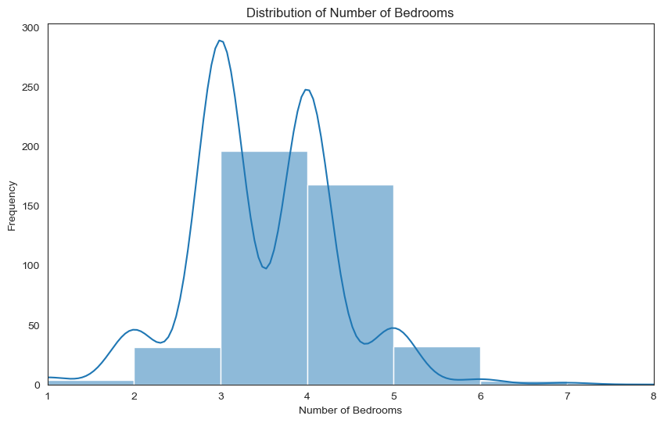
Histogram of Bedrooms

Slide 7
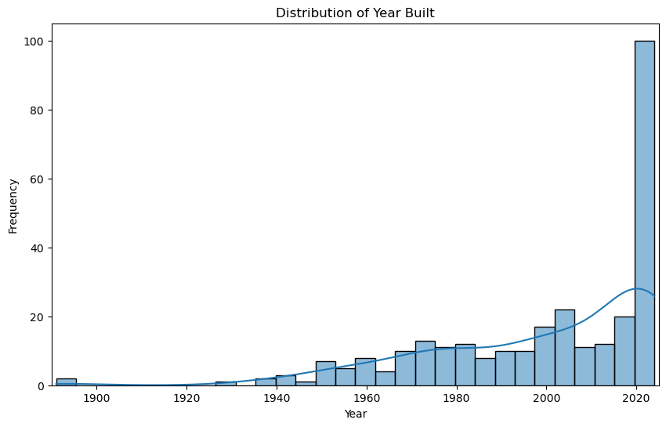
Histogram of Year Built

Slide 8
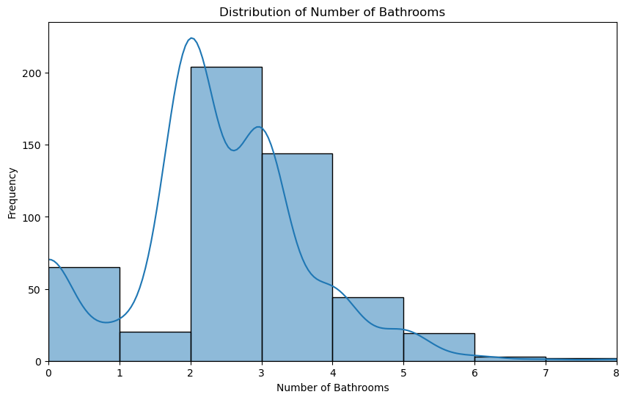
Histogram of Bathrooms

Slide 9
Descriptive Characteristics for Variables
List Price:
Mean: $510,668.58
Mode: $250,000.00
Spread: $1,318,409.27
Tails: Right skew
Bedrooms:
Mean: 3.5 bedrooms
Mode: 3.0 bedrooms
Spread: 0.9 bedrooms
Tails: Uniform
Bathrooms:
Mean:2.3 bathrooms
Mode: 2 bathrooms
Spread: 1.3 bathrooms
Tails: Random
Square Feet:
Mean: 1,560 sq. feet
Mode: 2,060 sq. feet
Spread: 3,220 sq. feet
Tails: Right skew
Year Built:
Mean: 1999
Mode: 2024
Spread: 25.4 years
Tails: Left skew

Slide 10
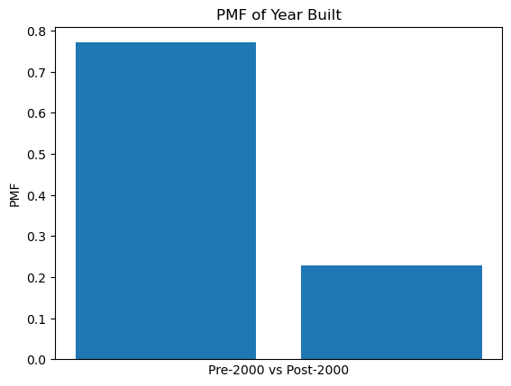
PMF
PMF displaying probability that a home is built before or after the year 2000.

Slide 11
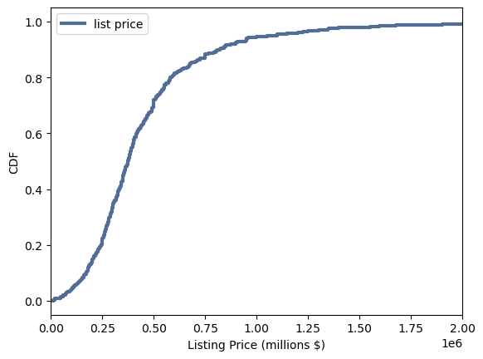
CDF
CDF of listing prices
CDF Prob = 0.946
CDF Value(0.5) = 374,990.0

Slide 12
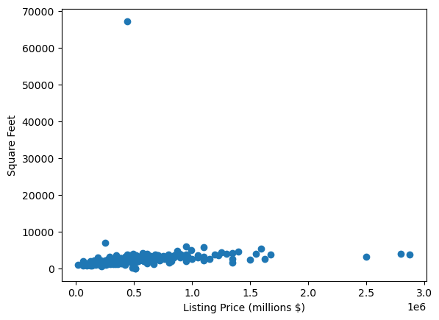
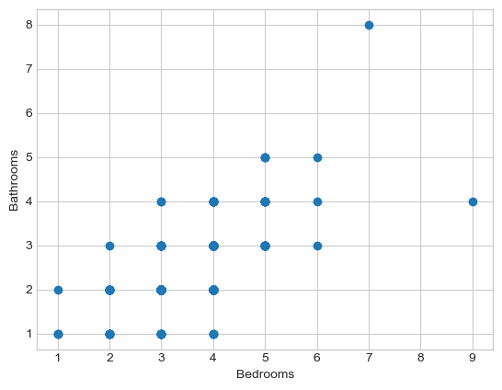
Scatter Plots
Listing Price (millions) vs. Square Feet
Bathrooms vs. Bedrooms

Slide 13
Hypothesis Test
H0 = Listing Price and Square Footage are dependent on each other.
H1 = Listing Price and Square Footage are independent of each other.
Test Statistic = 1,833,971.99
Critical Statistic = 504.39
p – value = 0.00
Because the p-value is smaller than the designated alpha value of 0.01, and the calculated test statistic is larger than the critical statistic, we can reject the null hypothesis. At this significance level, it can be concluded that listing price and square footage are independent of each other.

Slide 14
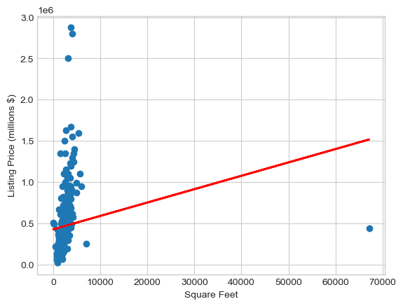
Regression Analysis
Price = 4.3e+05 + 16.2(x)
X = sqft
R2 = 0.03
Almost zero correlation. Therefore, square footage and listing price are not correlated.

